Slide 1

National Institute of Technology Meghalaya
CSE,GITA Autonomous College
Presented By
Name: SAYAD HASAN ALLI
Name: SAWAN CHOURASIA
Name: SHIBASISH KUMAR MISHRA
Roll No: 2002149
Roll No: 2002148
Roll No: 2002053

Slide 2
Presentation On:
Nikefy - Buy Footwear Online

Slide 3
Outline :
Introduction to Nikefy - Buy Footwear Online
Advantage and Disadvantage
Applications
Future Enhancement
Testing Result
Conclusion

Slide 4
What Is Nikefy- Buy Footwear Online ?
Nikefy is an innovative e-commerce web application designed to revolutionize the way people buy footwear online. With a user-friendly interface and a wide range of products, Nikefy aims to provide customers with a seamless shopping experience while offering the latest trends in footwear fashion.

Slide 5
Goals and Objective :
Establish Nikefy as a premier online destination for footwear shopping.
Provide a wide selection of footwear options.
Offer a convenient and user-friendly shopping experience.
Provide exclusive deals and discounts to attract customers.
Enhance customer satisfaction through easy returns and personalized recommendations.

Slide 6
Advantages of Nikefy - Buy Footwear Online
Wide Selection
Convenience and Accessibility
Exclusive Deals
Personalized Recommendations
Disadvantages of the Nikefy - Buy Footwear Online
Shipping Delays
Limited Stock
Sizing Issues

Slide 7
Its Applications are:
Individual customers for trendy footwear.
Retailers for expanding reach.
Fashion enthusiasts for latest styles.
Footwear manufacturers for showcasing their products to a wider audience.

Slide 8
Future Enhancement:
Enhance User Experience
Expand Product Range
Implement AR/VR Technology
Global Expansion

Slide 9
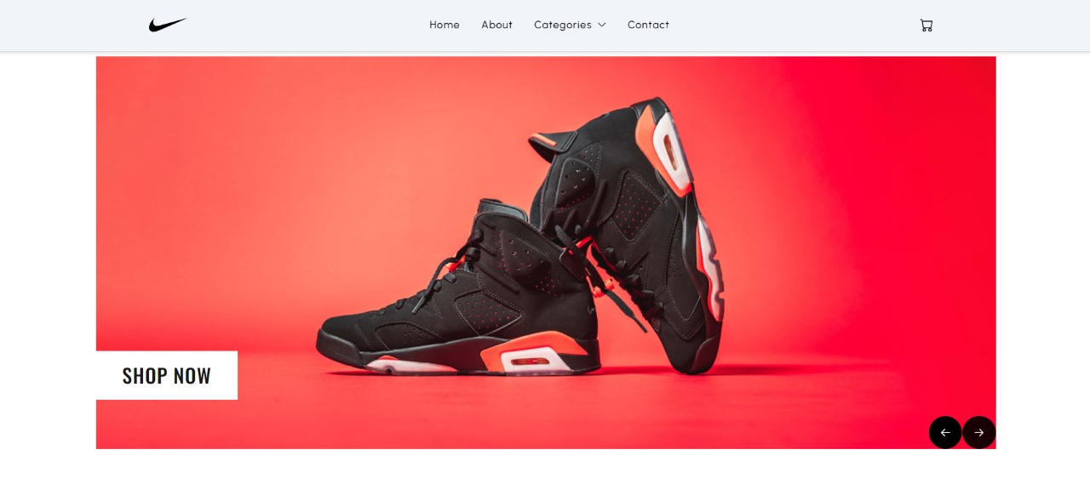
Testing and Resulting:

Slide 10
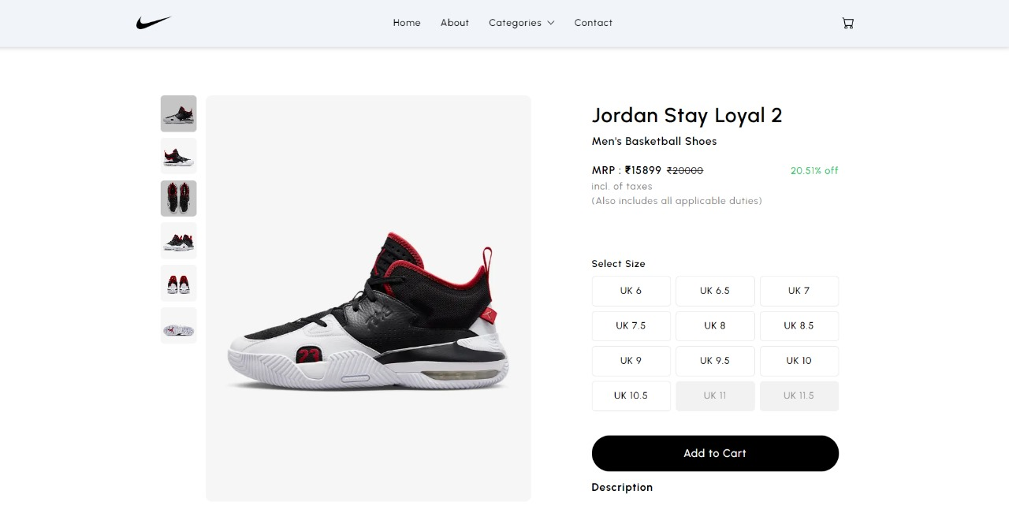

Slide 11
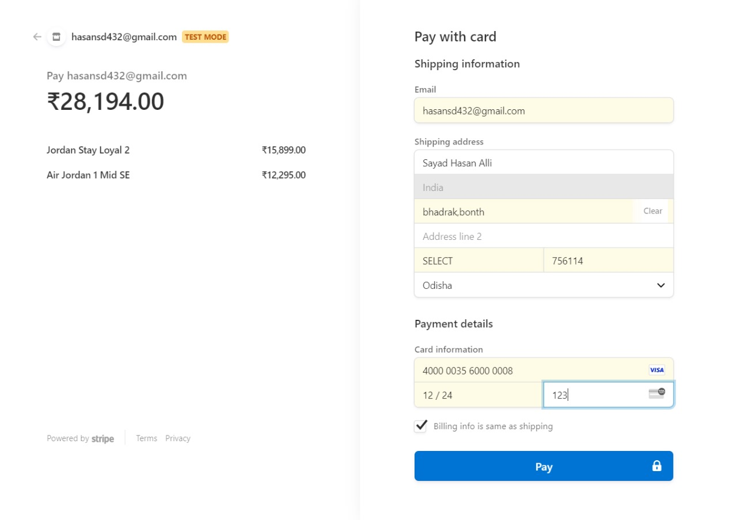

Slide 12
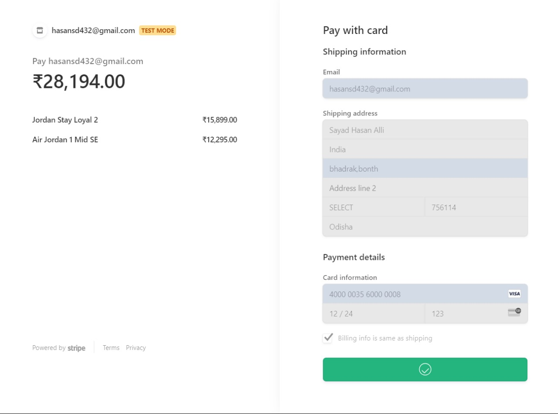

Slide 13
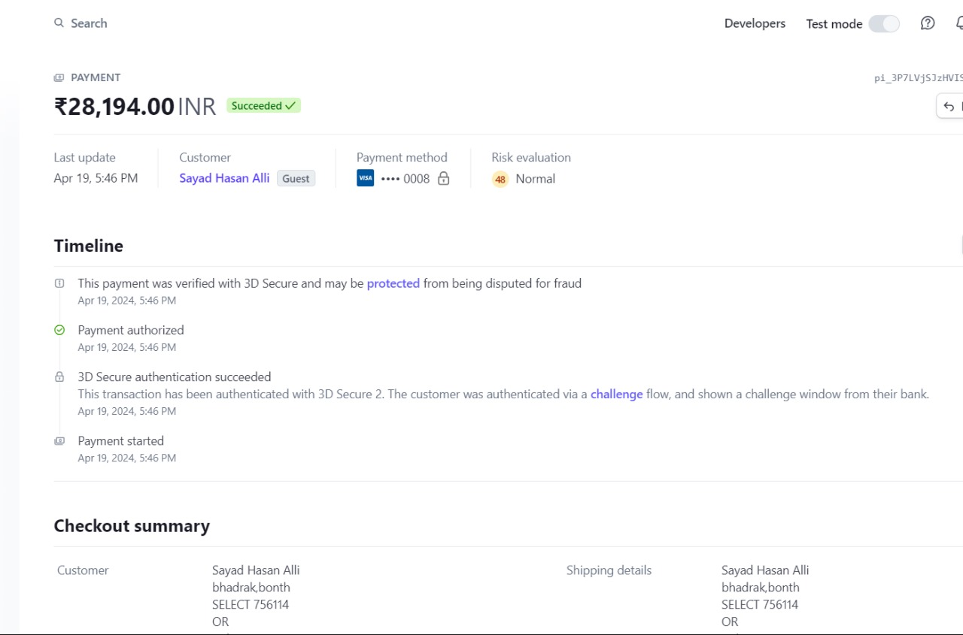

Slide 14


Slide 15
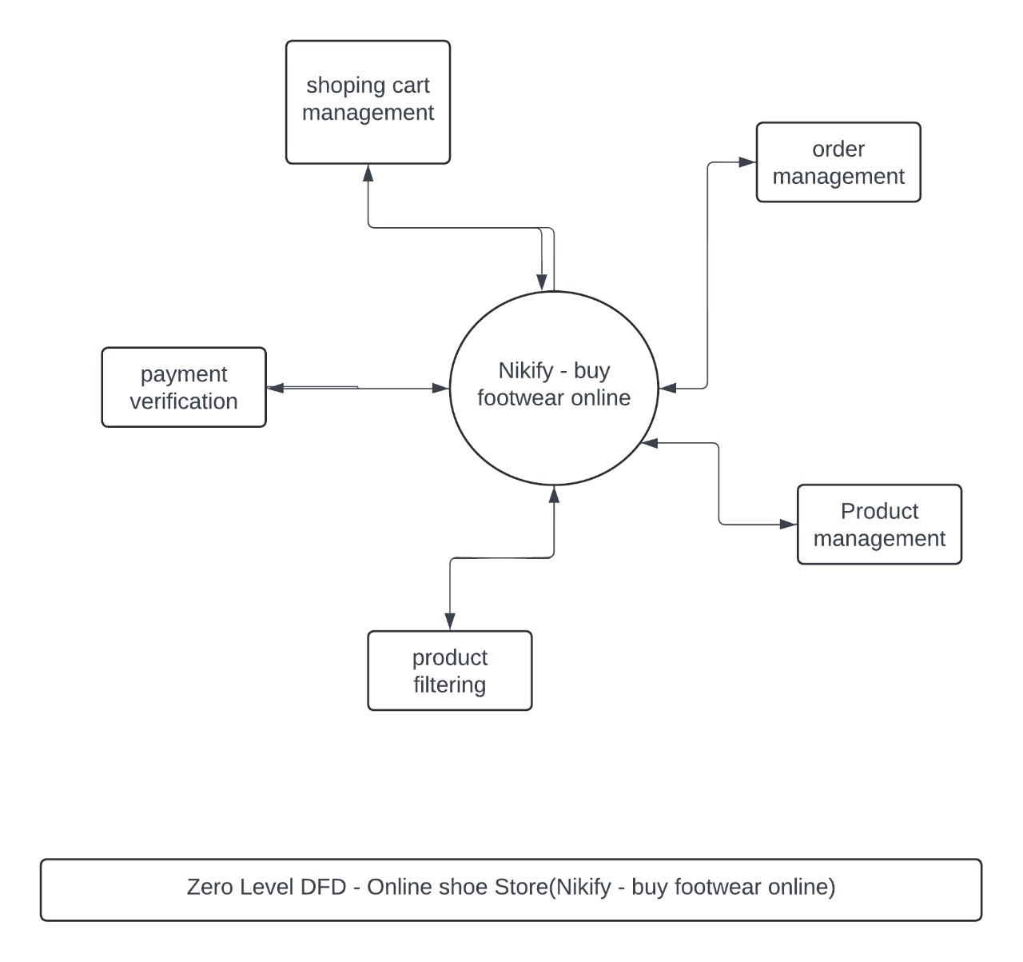

Slide 16
Conclusion :
In Conclusion Nikefy aims to be a leading destination for buying footwear online, offering a wide range of products, convenient shopping experience, and innovative features. While there are challenges such as shipping delays and sizing issues, Nikefy is committed to addressing these issues and continuously improving its services to meet customer expectations and stay ahead in the competitive e-commerce market.

Slide 17
THANK YOU

